Slide 1
Analyzing trends in electricity price and CO2 emissions in the United States
Group 9: Leela Prasad Dammalapati, Kedar Prashant Vichare, Tiffany Li, Utkarsh Tripathi
Department of Applied Data Science, San José State University
DATA 230 Business Intelligence and Data Visualization
Dr. Guannan Liu
December 4, 2024

Slide 2


Background
Objective: To analyze U.S. electricity pricing and CO2 emission patterns (2014-2023) to develop data-driven energy transition strategies.
Problem Statement
Analyze the relationship between electricity prices and CO2 emissions patterns across different sectors
Create comprehensive geospatial visualizations of price variations and CO2 emissions to identify regional trends and patterns
Design interactive dashboards comparing energy sources, pricing, and emissions to reveal long-term trends and relationships
Develop and evaluate machine learning models to predict electricity prices based on historical data

Slide 3

Data Collection
1. CO2 Emissions dataset
Source: CO2 Emissions by state and sector
Time Period: 2014 – 2022
Columns: Period, Sector ID, Sector Name, Fuel ID, Fuel Name, State ID, State Name, Value
2. Retail Electric Sales Data
Source: Electricity sales to ultimate customers
Time Period: 2014 – 2023
Columns: Period, State ID, State Description, Sector ID, Sector Name, Customers, Price, Revenue, Sales, Customers Units, Price Units, Revenue Units, Sales Units
4. Emissions by State by Fuel
Source: State specific data
Time Period: 2014 – 2023
Columns: Period, State ID, State Description, Fuel ID, Fuel Description, CO2 Rate (lbs/MWh), CO2 (Thousand Metric Tons), NOx Rate (lbs/MWh), NOx (Short Tons), SO2 Rate (lbs/MWh), SO2 (Short Tons)

Slide 4
Data Processing
Aggregate data based on time periods (monthly or yearly), sectors, or states, to analyze overall trends.
Remove any unnecessary columns (like units) and rename columns for better readability.
Check the data structure, column names, and types.
Data Loading
Inspect Data Type & Structure
Convert Data Type
Drop Unit Column Update Column Names
Remove Outliers
Data Aggregation
Processed Data
Load data from EIA API into a DataFrame.
Convert relevant columns like period to datetime and others to numerical types.
Identify and handle outliers in columns like sales and price to ensure the data quality.

Slide 5
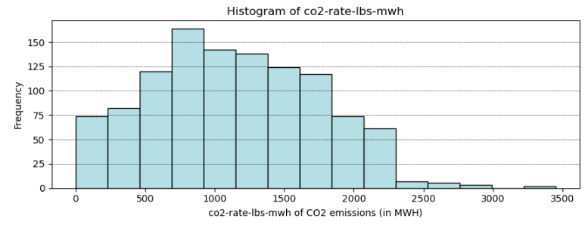
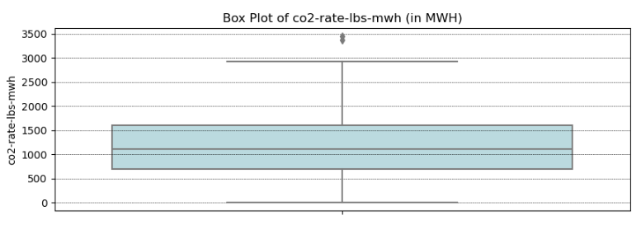
Univariate Analysis

Slide 6
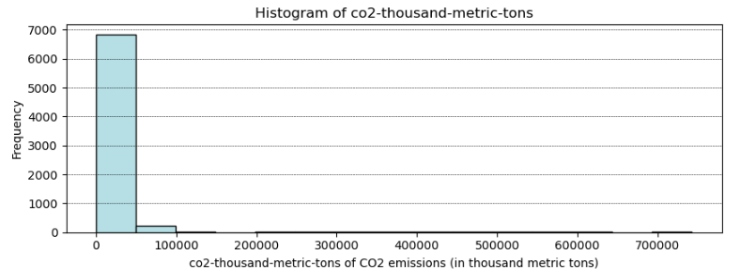
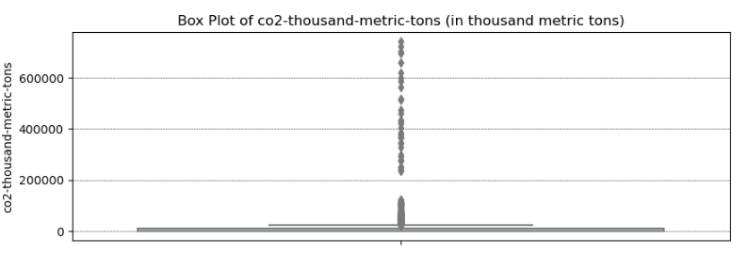
Univariate Analysis

Slide 7
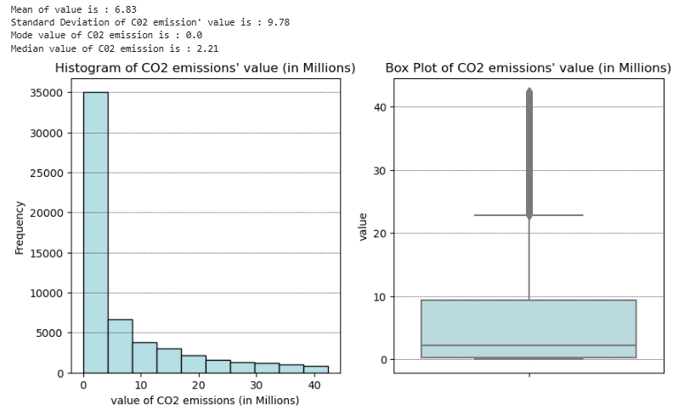
Univariate Analysis

Slide 8
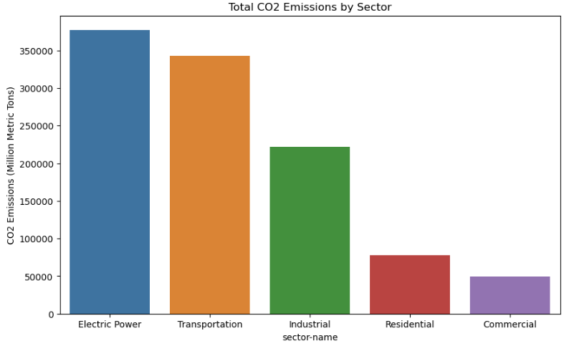
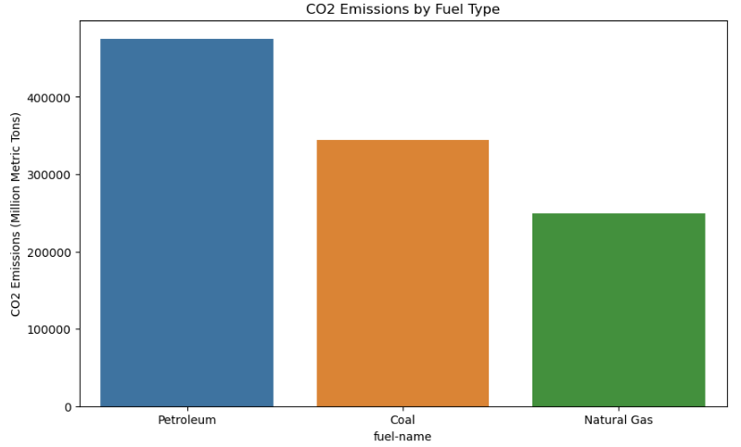
EDA – CO2 Emissions Dataset

Slide 9
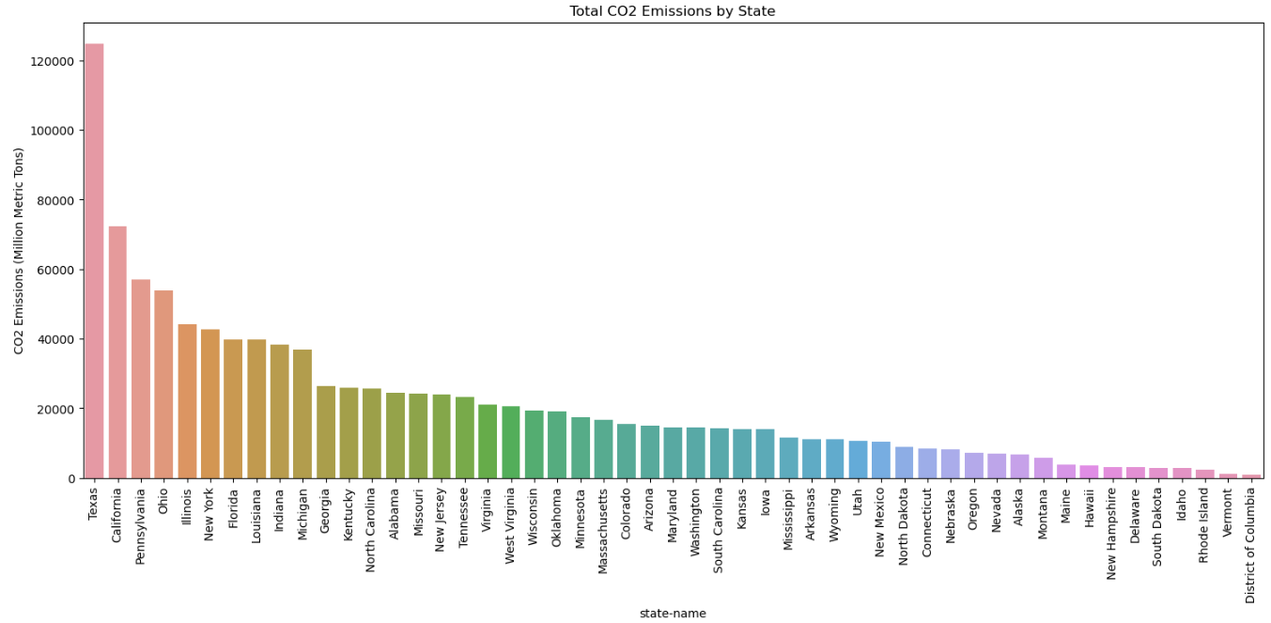
EDA – CO2 Emission by State for All Sectors

Slide 10
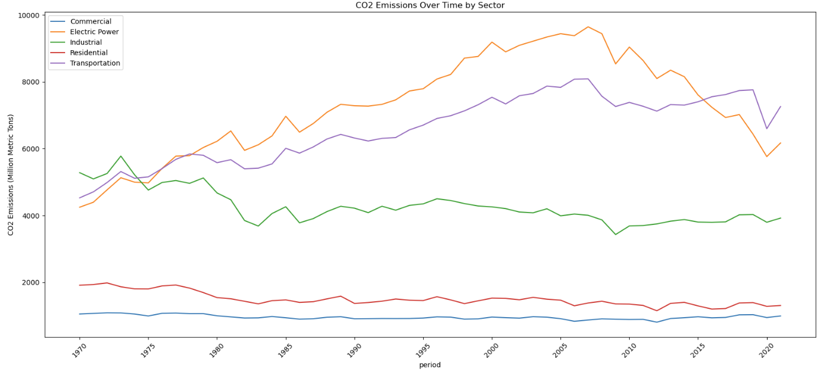
EDA – CO2 Emissions Over Time by Sector

Slide 11
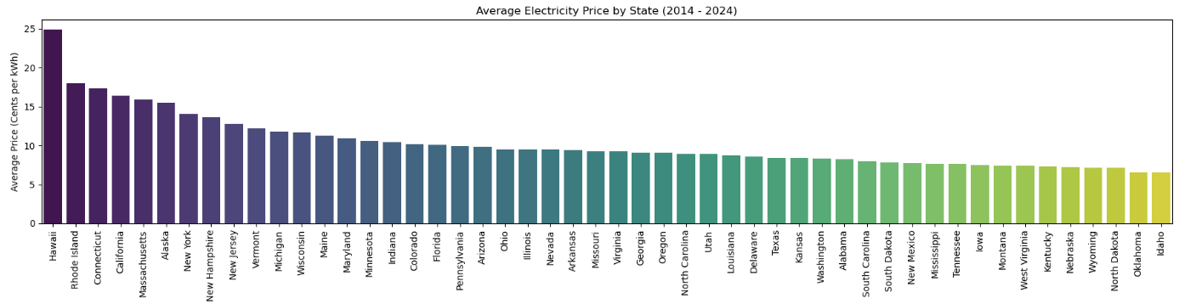
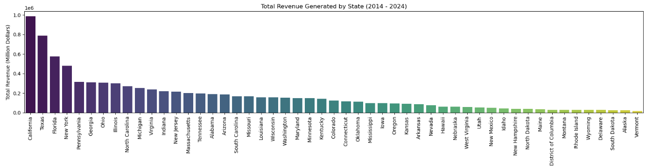
EDA – Average Price & Total Revenue by State

Slide 12
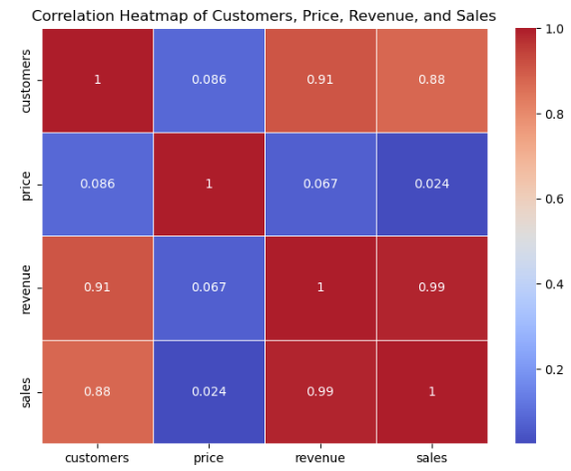
Correlation Analysis

Slide 13
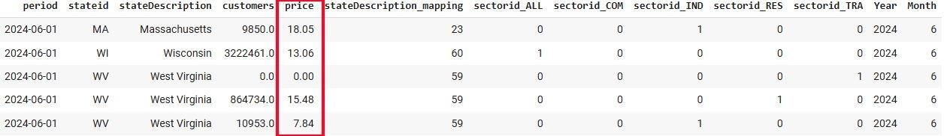
Machine Learning
Model Selection: We implemented two machine learning models — Linear Regression and Random Forest — to identify the best-performing model for predicting electricity prices.
Feature Selection
Input Features (X):
Number of customers: A key indicator of demand
State descriptions: Encoded to capture regional variations
Sector-specific variables: Five different sectors represented through one-hot encoding
Temporal features: Year and Month to capture seasonal patterns
Target Variable (y): price (electricity price)
Train-Test-Validation Data Split
Training Set: 60% of the data
Validation Set: 20% of the data
Test Set: 20% of the data

Slide 14
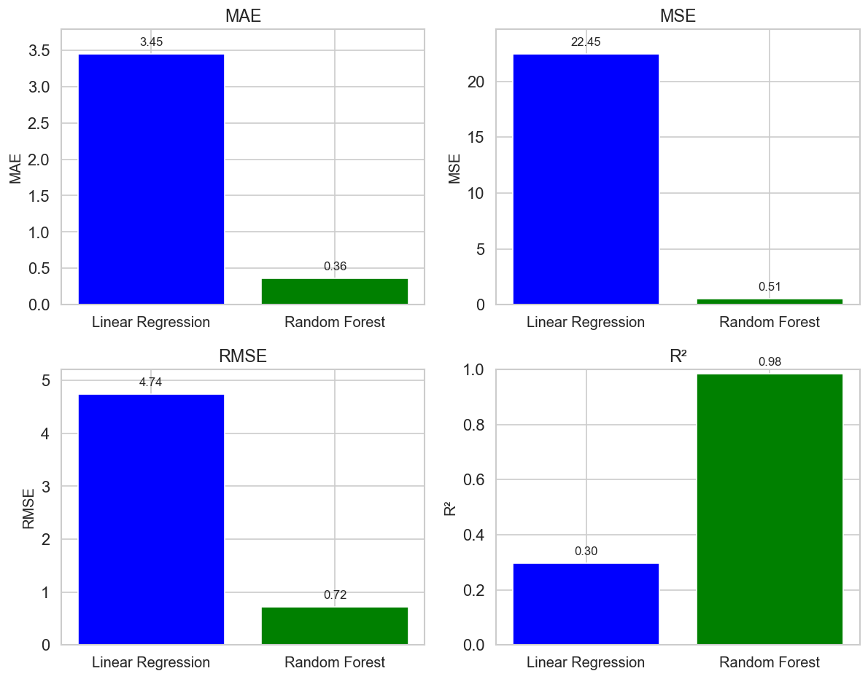
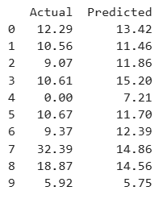
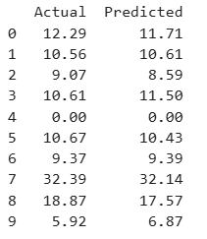
Results
Evaluation Metrics Comparison Between LR & RF
Linear Regression
Random Forest
MAE: Average absolute error between predictions and actual values. Lower is better.
MSE: Mean of squared errors, emphasizing large errors. Lower is better.
RMSE: Square root of MSE, in original units for better interpretability. Lower is better.
R²: Proportion of target variance explained by the model. Higher is better.

Slide 15
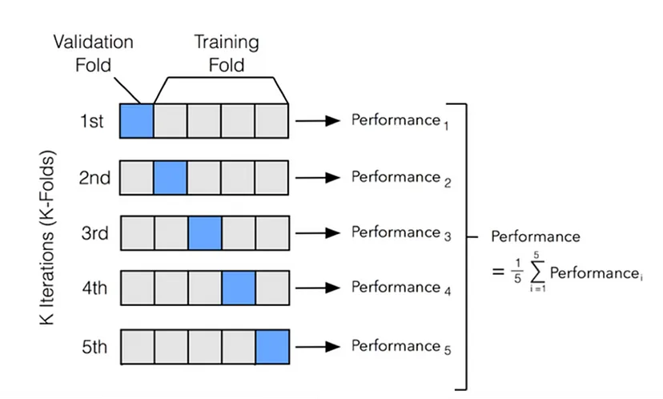
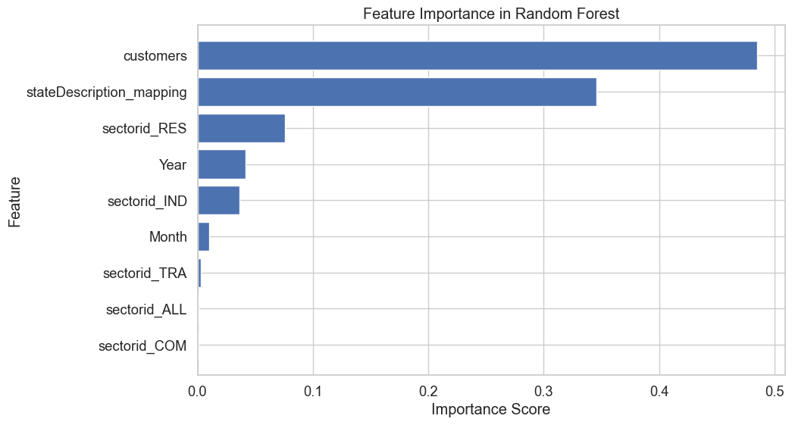

Results
Cross-Validation Results
Feature Importance Random Forest
To evaluate the model's ability to generalize to unseen data, we used 5-fold cross-validation.
The results show that the Random Forest model outperforms Linear Regression in generalizing to new data.
Top Features: customers (0.4847), stateDescription_mapping (0.3458)
Moderately Important Features: sectorid_RES (0.0759), Year (0.0416)
Least Important Features: sectorid_IND (0.0367) and Month (0.0100),
Other Sectors (sectorid_TRA, sectorid_ALL, sectorid_COM)

Slide 16
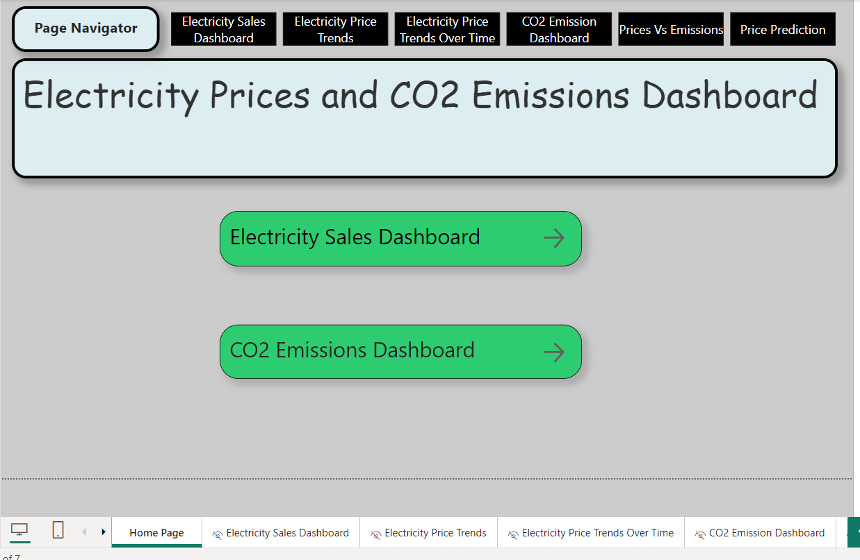
Interactive Dashboard Demo
Refer to the Power BI file

Slide 17
Conclusion
Our analysis used interactive visualizations and predictive modeling to uncover patterns in U.S. electricity pricing and emissions data (2014-2023).
Tools and Technical Implementation
Interactive Dashboards: Power BI for dynamic visualization and user interaction
Data Processing: Python ecosystem (Pandas, NumPy) for robust analysis
Machine Learning: Scikit-learn for price prediction modeling
Visualization Libraries: Matplotlib and Seaborn for statistical insights
Key Insights
Price Dynamics: 22.55% increase over 9 years, with residential sector leading at 14¢/unit ($5.81M revenue), highlighting consumer impact.
Emissions Picture: Minimal growth (0.60%) with Transportation (36.1%) and Electric Power (33.61%) as major contributors.
Geographic Impact: Significant regional variations in prices (Rhode Island, Connecticut leading) with no direct correlation to emission levels.
Market Structure: Clear sector hierarchy from Residential ($5.81M) to Transportation ($0.02M) in revenue distribution.
Energy Sources: Petroleum leads CO2 emissions, followed by Natural Gas, showing consistent patterns.
Post-2020 Trends: Accelerated price growth across sectors while emissions remained stable.
Takeaways
Our findings point to key areas for improving U.S. energy use. Since transport and power create most emissions (70%), we should focus on reducing these first. Big price differences between states show we need better price control across regions. Adding more renewable energy could help keep prices steady. Lastly, since each sector (homes, businesses, factories) uses energy differently, we need specific plans for each group to make changes work better.

Slide 18
Thank you!
Leela Prasad Dammalapati, Kedar Prashant Vichare, Tiffany Li, Utkarsh Tripathi

